Slide 1

4
Harmeet Singh Sehra

Slide 2
Migration from Tableau to POWER BI

Slide 3
Migration from Tableau to POWER BI
Do u feel in migration from tableau to power bi, before migrating visualization from tableau to power bi, we should also understand dataset from tableau as well. or what u feel we should follow in terms of steps. I mean tableau project is already created by someone and our job is to migrate to power bi.
what should i follow?

Slide 4
Understanding the dataset is NOT optional. It’s the foundation.
If you skip that and jump straight into visuals, your Power BI report will look similar but behave wrong.
Let see a practical migration approach (real-world style)

Slide 5
Tableau → Power BI Migration Strategy

Slide 6
1. Understand the Business First (NOT the tool)
Before even opening anything:
What is this dashboard solving?
Who uses it? (Sales head, manager, analyst)
What decisions are taken?
Many people skip this and blindly copy charts — big mistake

Slide 7
You’re not migrating a dashboard… => You’re migrating decision-making capability
A. What is this dashboard solving?
Don’t think in terms of charts. Think in terms of business problems.
B. Who uses it?
This changes EVERYTHING in Power BI design.

Slide 8
Visual Mapping to PURPOSE
Dashboard Type | Real Purpose
Sales Dashboard | Track revenue, identify low-performing regions
Marketing Dashboard | Measure campaign effectiveness
Operations Dashboard | Monitor delays, inefficiencies

Slide 9
Practical Approach (When Tableau File is Given)
When you open Tableau:
Step 1:
Pick ONE sheet at a time
Step 2:
Ask:
What question is this answering?
Who would care about this?
Step 3:
Write it like: “This visual helps [user] to [decision]”

Slide 10
2. Analyze Tableau Dashboard (Front-End)
Open Tableau and check:
All sheets (charts)
Filters (global vs local)
Actions (drill-down, highlight, navigation)
Calculated fields

Slide 11
Create a simple mapping like:
Sheets mapping
Filters mapping
Actions mapping
Calculations mapping

Slide 12
A. All Sheets (Charts)
In Tableau:
Each chart = Sheet
Dashboard = combination of multiple sheets
For EACH sheet:
1. Chart Type : Bar, Line, Map, Table, KPI, etc.
2. Fields Used
Dimension → Category (Region, Product)
Measure → Values (Sales, Profit)
3. Aggregation Level
SUM(Sales)
AVG(Profit)
COUNTD(Customer)
4. Granularity
“At what level is this chart showing data?”
Region level
Product level
Date level
5. Hidden Logic
Top N filters
Conditional formatting
Custom grouping
B. Filters (VERY IMPORTANT)
Filters define how users interact.
1. Global Filters (Apply to all sheets)
Use Slicers
2. Local Filters (Sheet-level)
Visual-level filters
3. Context Filters (Affect other filters)
Managed via DAX / relationships

Slide 13
C. Actions (CRITICAL for behavior)
This is where Tableau is very interactive.
1. Filter Action (Drill-down)
Click on chart → filters another chart
Power BI: Default cross-filtering OR Drill-through
2. Highlight Action
Hover/click → highlights related data
Power BI: Cross-highlighting (automatic)
3. Navigation Action
Button → moves to another dashboard
Power BI: Buttons + Page navigation
4. URL Action
Click → opens link
Power BI: Buttons / conditional formatting with URLs
D. Calculated Fields (Brain of Dashboard)
Types of Calculations in Tableau
1. Simple Calculations
Profit Ratio = SUM(Profit) / SUM(Sales)
DAX Measure
2. IF Conditions
IF SUM(Sales) > 10000 THEN "High" ELSE "Low" END
IF / SWITCH
3. LOD Expressions (VERY IMPORTANT)
{ FIXED [Region] : SUM(Sales) }
CALCULATE + ALL / ALLEXCEPT
4. Table Calculations
Running total
DAX time intelligence

Slide 14
3. Understand Dataset (MOST CRITICAL STEP)
This is where most migrations fail.
Check in Tableau:
Data Source tab
Joins / relationships
Extract vs Live connection
Custom SQL (if used)

Slide 15
Tableau shows visuals But dataset defines truth

Slide 16
You must identify:
Fact table (Sales, Transactions)
Dimension tables (Region, Product, Date)
Calculated columns already created
Aggregation level (row-level or summary)

Slide 17
A. Data Source Tab (Your Starting Point)
Open Tableau → Go to Data Source
1. Number of Tables
Single table?
Multiple tables?
Think of:
Simple model vs complex model in Power BI
2. Table Names & Meaning
Orders
Customers
Products
Think of:
Which is transactional?
Which is lookup?
B. Joins / Relationships (CRITICAL)
Tableau allows:
Joins (physical layer)
Relationships (logical layer)
1. Join Type
Inner
Left
Right
Full
2. Join Keys
Orders.CustomerID = Customers.CustomerID
3. Many-to-Many Issues
Both tables have duplicates

Slide 18
C. Identify Fact & Dimension Tables (CORE CONCEPT)
1. Fact Table (Main Data)
Contains:
Transactions
2. Dimension Tables (Descriptive Data)
Contains:
Labels / categories
D. Custom SQL (Hidden Logic)
In Tableau:
Sometimes data is not tables
It’s SQL query
Example:
SELECT Region, SUM(Sales) as TotalSales
FROM Orders
GROUP BY Region
This is already aggregated

Slide 19
F. Calculated Columns in Tableau
Fields created in Tableau
Types:
1. Row-level calculations
Profit = Sales - Cost
Calculated Column
2. Aggregated calculations
SUM(Sales)
Measure

Slide 20
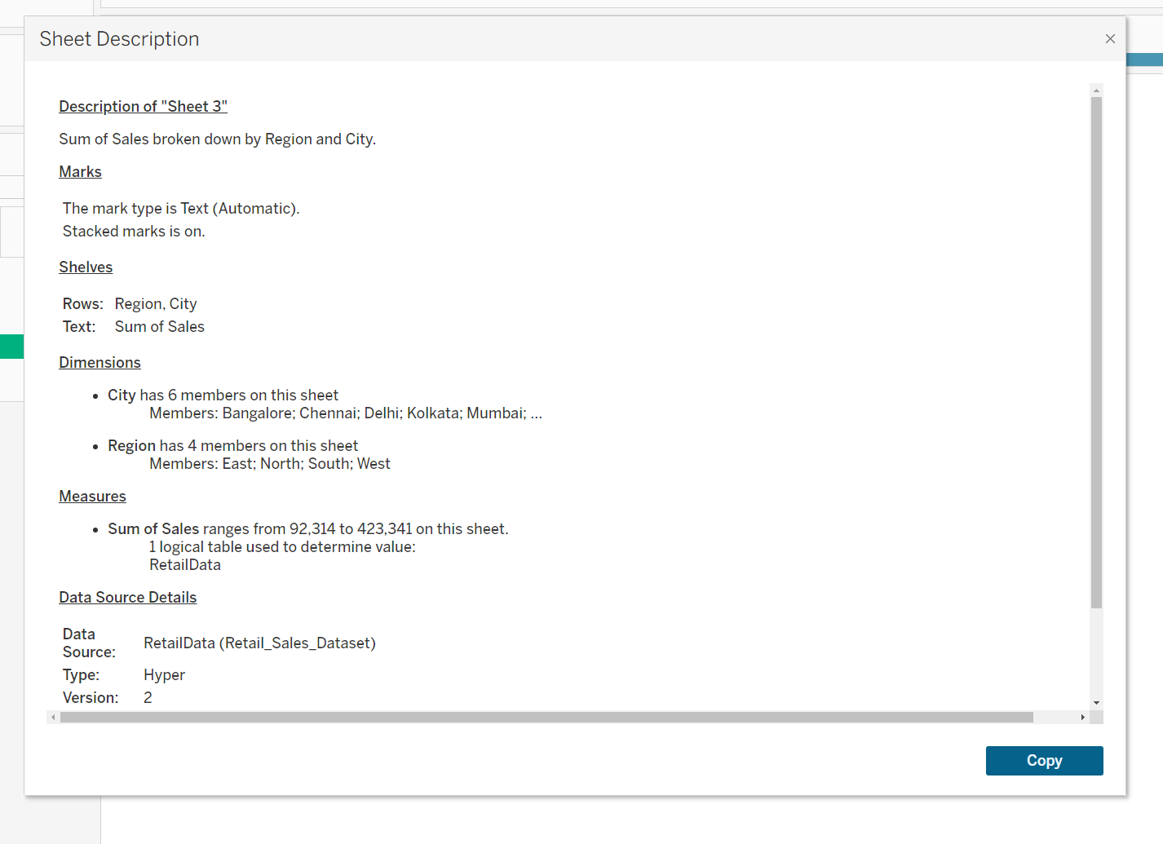

Slide 21
4. Extract / Get Data from Tableau
Options:
Export data (if allowed)
Access original source (best option)
Reuse SQL queries from Tableau

Slide 23
5. Data Modeling in Power BI
This is where Power BI is stronger than Tableau.
Create Star Schema
Fact table in center
Dimension tables around
Define relationships
Create Date table (important)

Slide 24
A Star Schema is a data modeling approach where:
One central table (Fact)
Multiple surrounding tables (Dimensions)
Step 1: Identify FACT vs DIMENSIONS
Step 2: Replace Text with IDs
Step 3: Create Relationships in Power BI

Slide 25
6. Recreate Calculations (Tableau → DAX)
Examples:
Tableau FIXED → DAX CALCULATE + ALL
Tableau IF → DAX SWITCH / IF
Tableau LOD → DAX context functions

Slide 26
7. Rebuild Visuals
Now recreate:
Charts
Layout
Colors (optional)
Interactions

Slide 27
8. Validate Results (VERY IMPORTANT)
Compare:
Tableau numbers vs Power BI numbers
Filters behavior
Totals and subtotals

Slide 28
9. Optimize & Enhance
Now improve:
Performance
UX (cards, tooltips, bookmarks)
Add extra insights

